Slide 1
WEB-BASED CHAT APPLICATION
PRESENTED BY : HARISHANKAR KUMAR YADAV
UNIVERSITY ROLL NO.: 191500314
GLA UNIVERSITY, MATHURA

Slide 2
CONTENTS
INTRODUCTION
MODULE AND DESCRIPTION
HARDWARE AND SOFTWARE SPECIFICATION
FRONT END AND BACK END
DFD
SCREEN SHOTS
CONCLUSION
FUTURE REFERANCE

Slide 3
INTRODUCTION
Our project is an example of chat application which is basically based on private chatting (message is broadcast to only single connected user)
It is made of two application
Client Application which runs on user’s Pc
Server application which runs on any Pc on the network
To start chatting client should get connected to server.

Slide 4
MODULES
Server Modules:-
A server is a specially equipped computer connected to the internet that allows users with chat clients to converse with one another via typed message in real time.
Client Module:-
A client is a software program that allows users to connect to chat servers and communicate with other users via a chat room.

Slide 5
HARDWARE SPECIFICATION
RAM-2GB
HARD DISK-5GB
PROCESSER-INTEL PENTIUM 4
KEYBOARD-104 KEYS

Slide 6
SOFTWRE REQUIREMENT
MICROSOFT VISUAL CODE
XAMPP CONTRO PANEL v3.3.0
CHROME BROWSER
WINDOWS 7 OR HIGHER

Slide 7
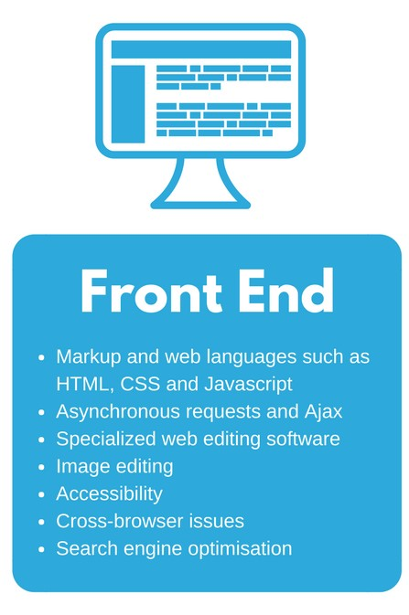
FRONT END
HTML
CSS
JAVASCRIPT

Slide 8
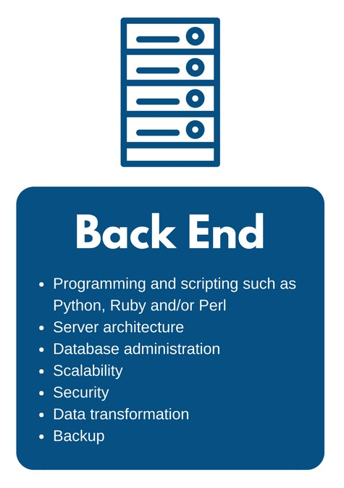
BACK END
DATABASE MANAGEMENT
PHP

Slide 9
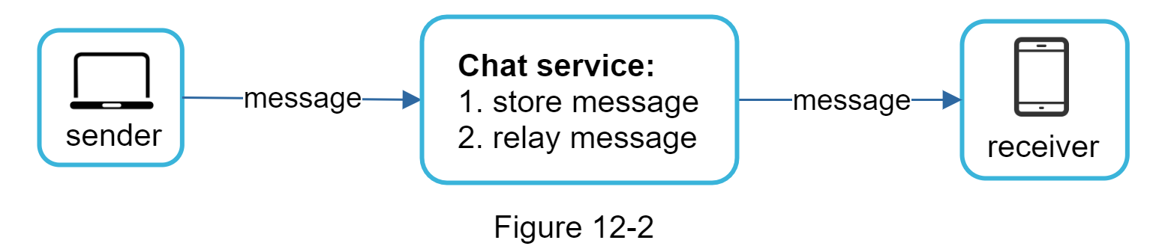
DFD
0 Level DFD

Slide 10
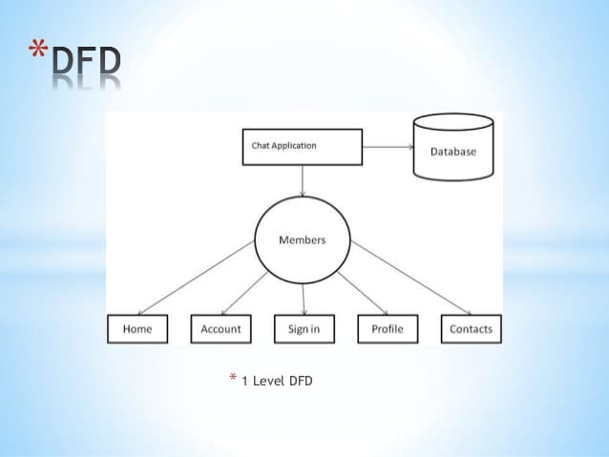
DFD

Slide 11
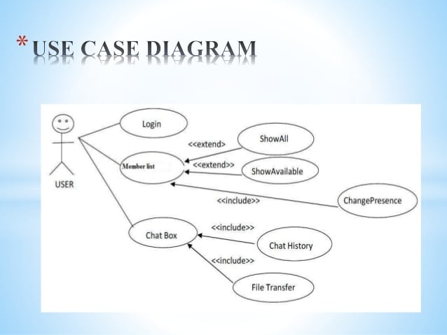
USE CASE DIAGRAM

Slide 12
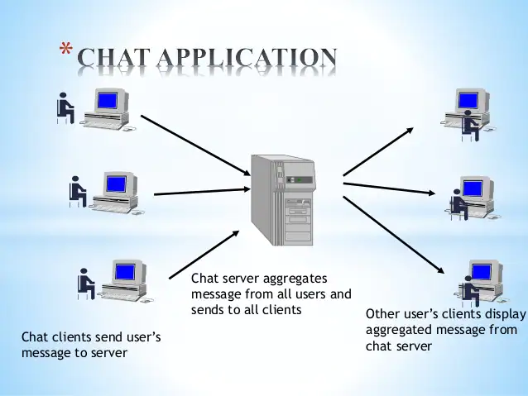
CHAT APPLICATION

Slide 13
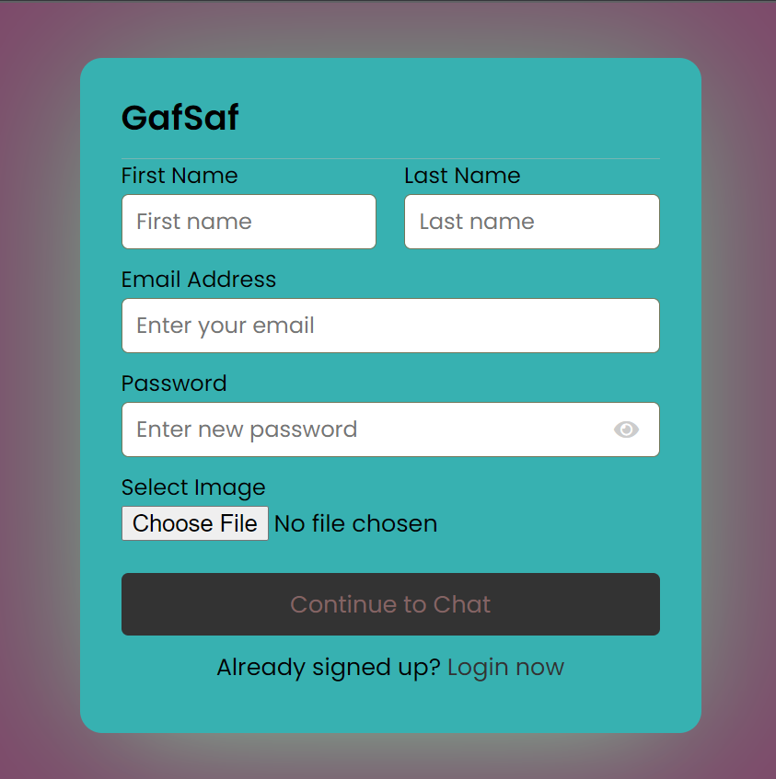
SCREEN SHOTS
CREATE NEW ACCOUNT PAGE

Slide 14
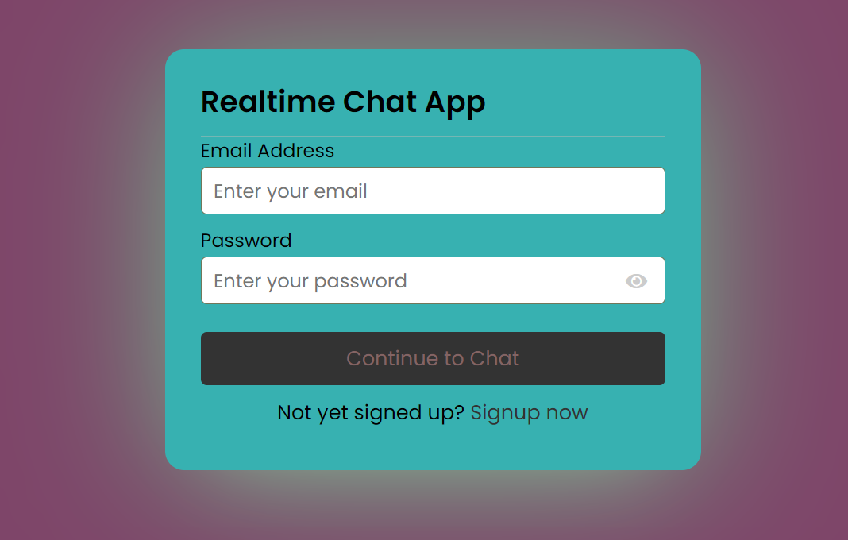
LOGIN PAGE

Slide 15
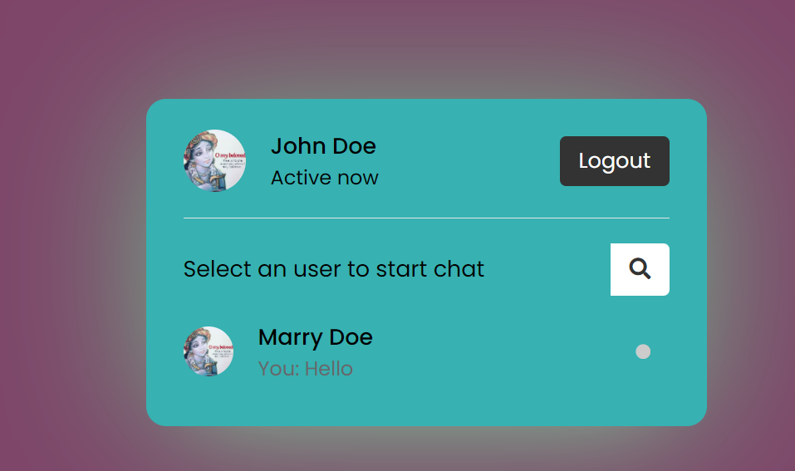
LOGOUT AND SEARCH FRIEND PAGE

Slide 16
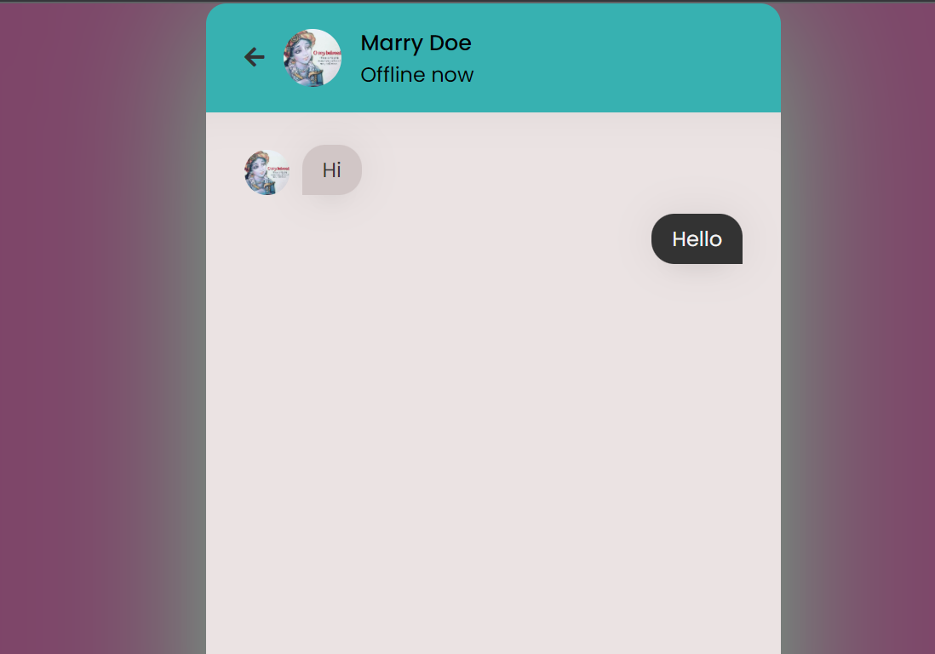
CHATROOM PAGE

Slide 17
CONCLUSION AND SCOPE
There is always a room for improvements in any software package, however good and efficient it may be done. But the most important thing should be flexible to accept further modification Right now we are just dealing with text communication. In future this software may be extended to include feature such as:
File transfer: this will enable user to send files of different formats to others via the chat application.
Voice chat: this will enhance the application to a higher level where communication will be possible via voice calling as in telephone.

Slide 18
THANK YOU

